Slide 1
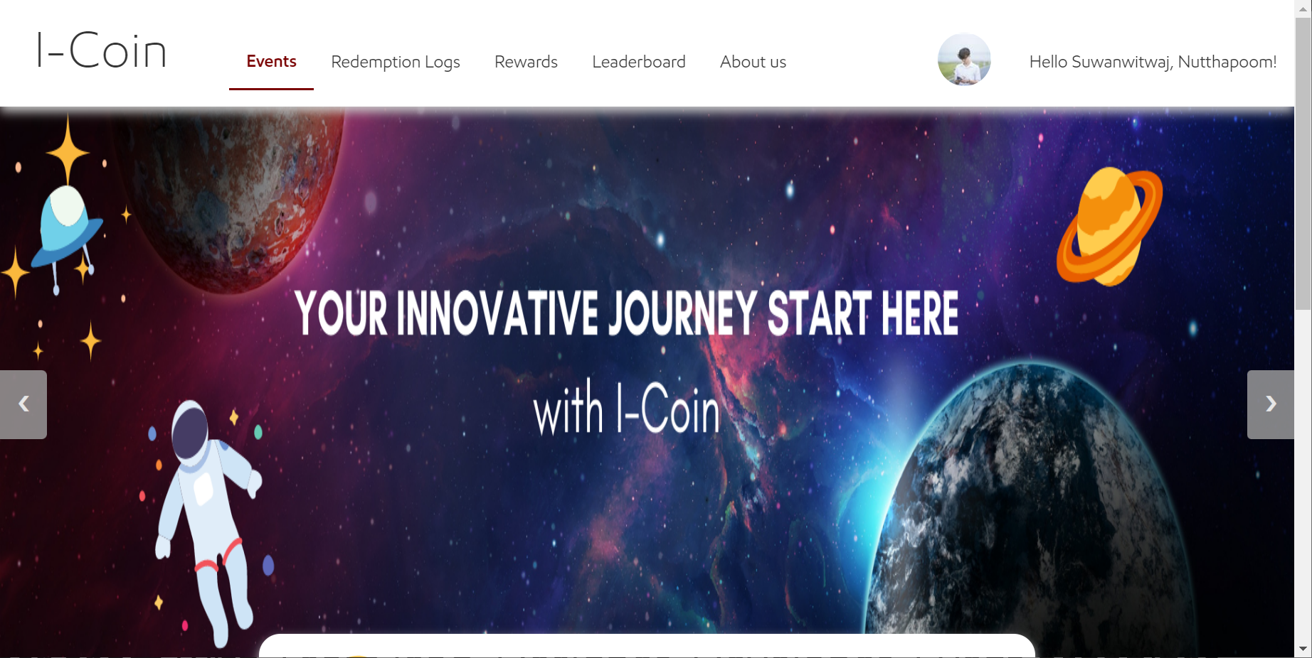
ICoin
Since December 2021
1500 Transaction
320 Users
Rewarded 37 voucher
Quiz & Idea/Improvement hub
38 Idea submitted
3 quizzes form with 65 responses
30+ events

Slide 2
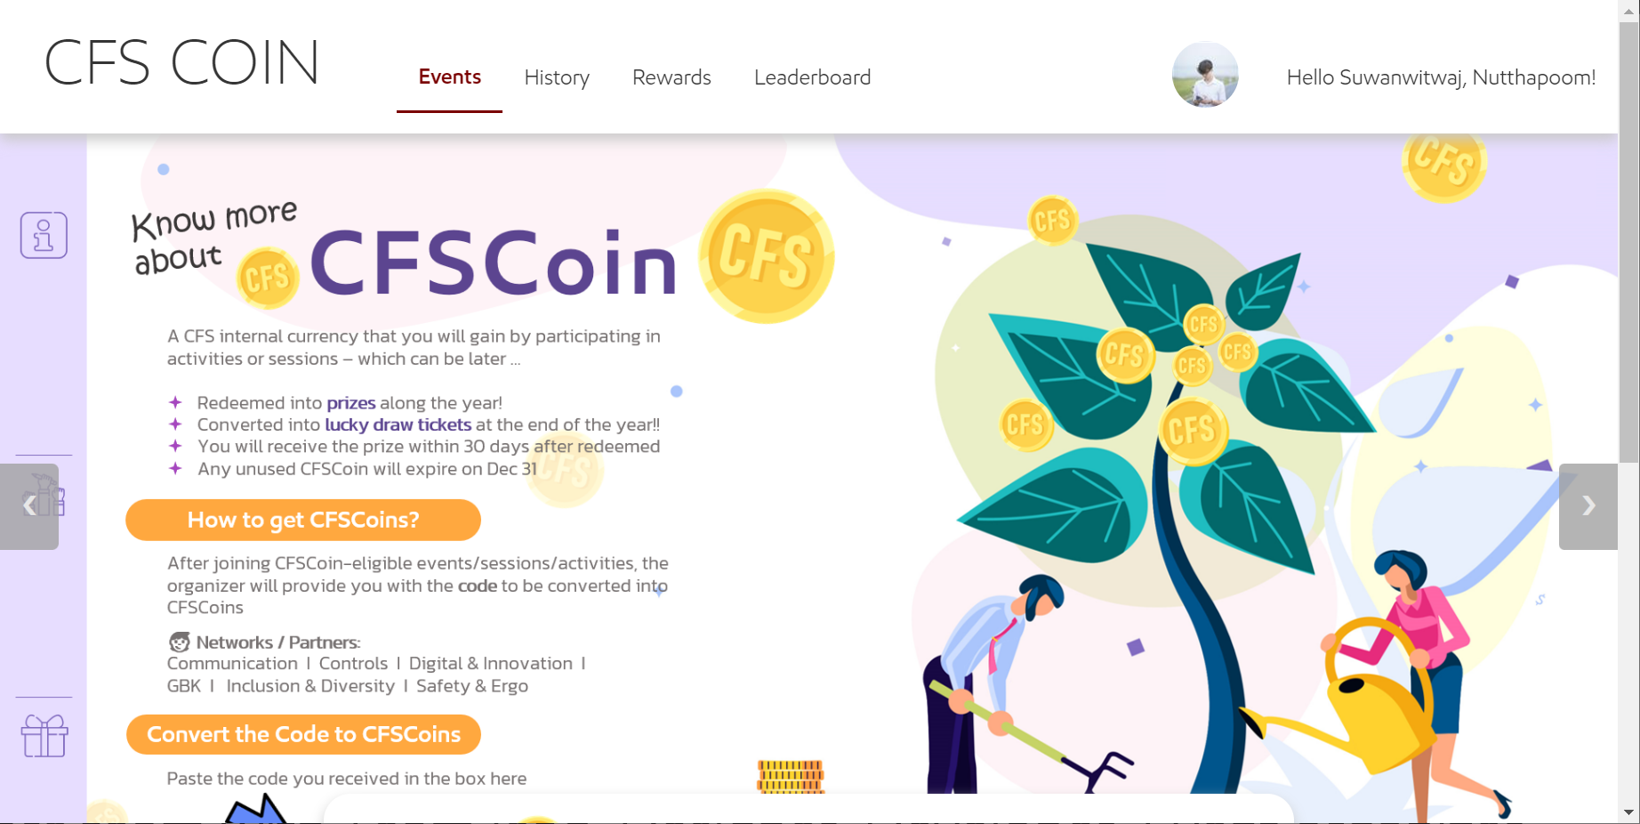
CFSCoin
Since June 4
Training and team building
350 users
21 events
5 Voucher and 100+ lucky tickets

Slide 3
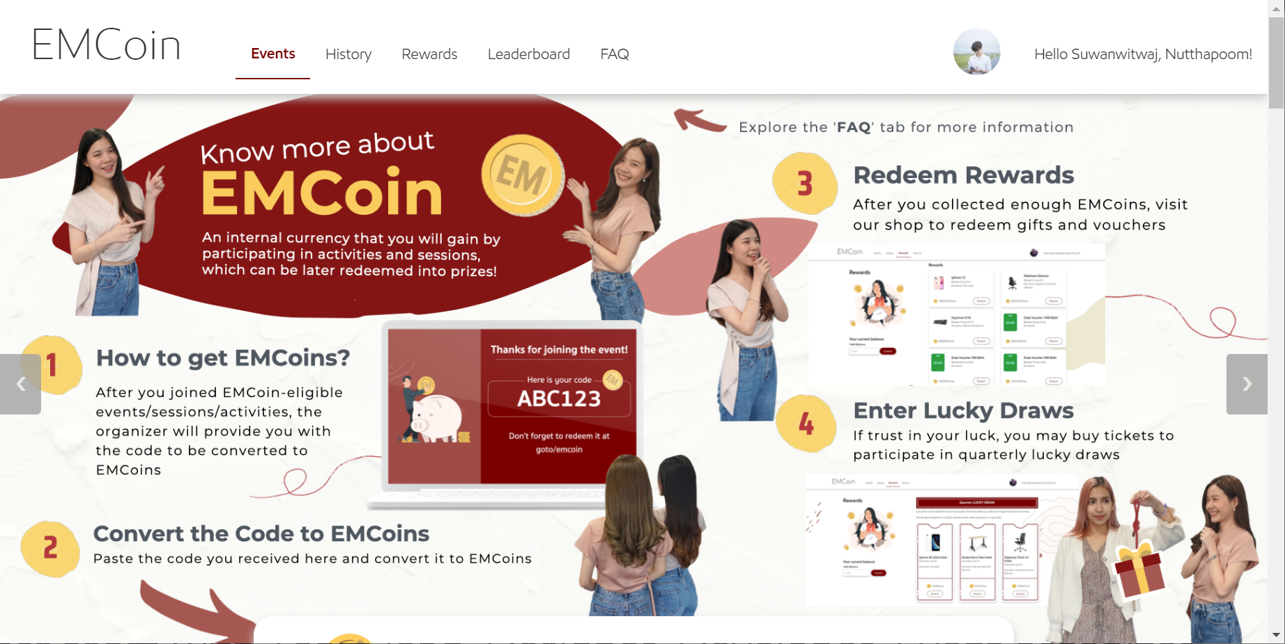
EMCoin
Since Jan 2022
30k+ Transaction
70+ events & activities
86 items rewarded
2500+ lucky draw tickets (50 EMCoin each)
Core team with Team lead, Designer, Developer, Event organizer, Marketing

Slide 4

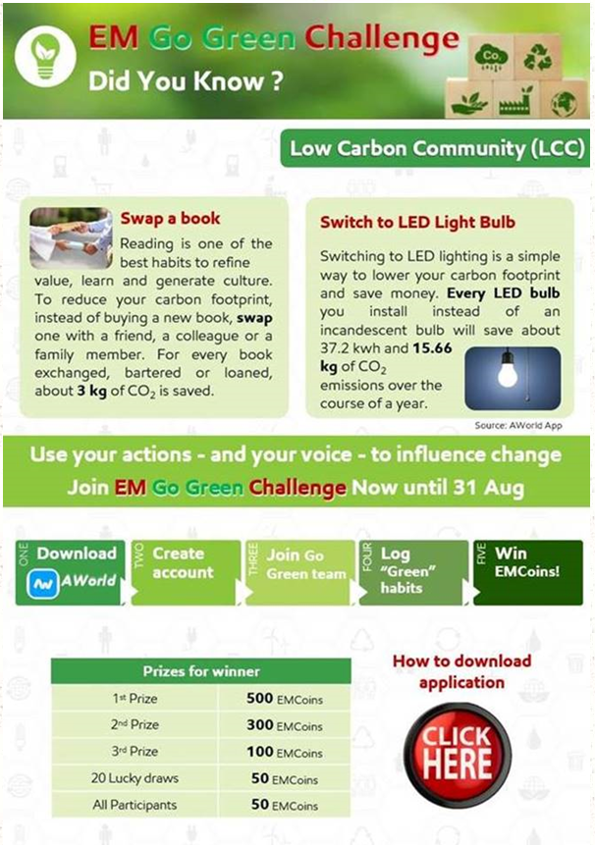
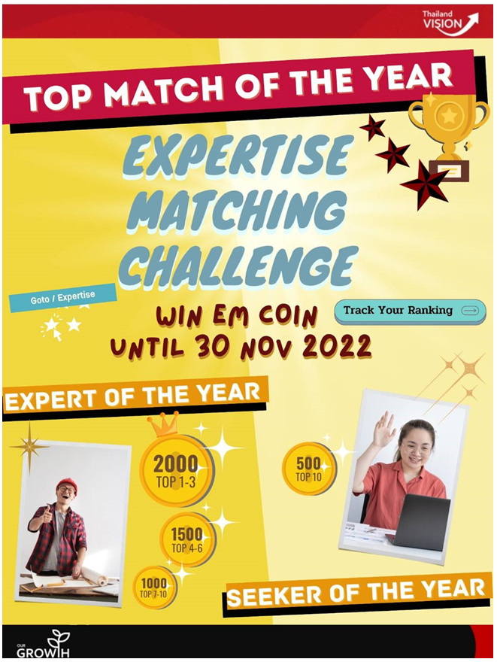


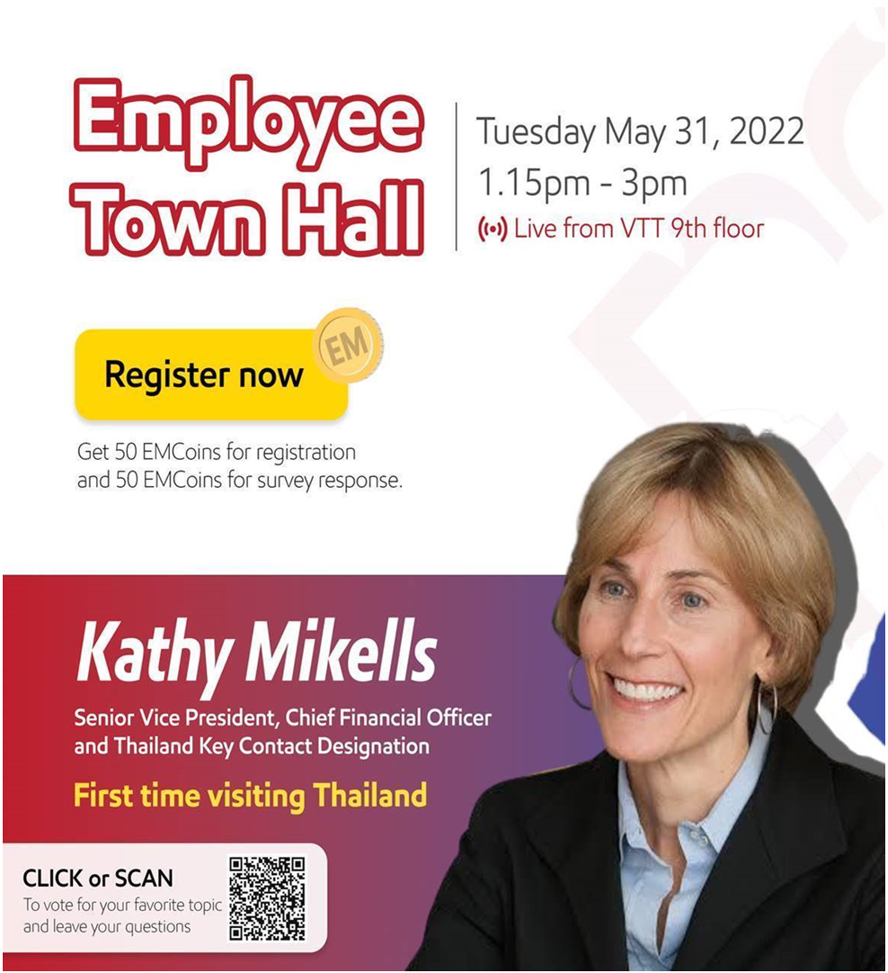


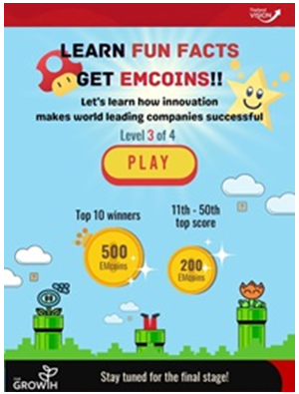
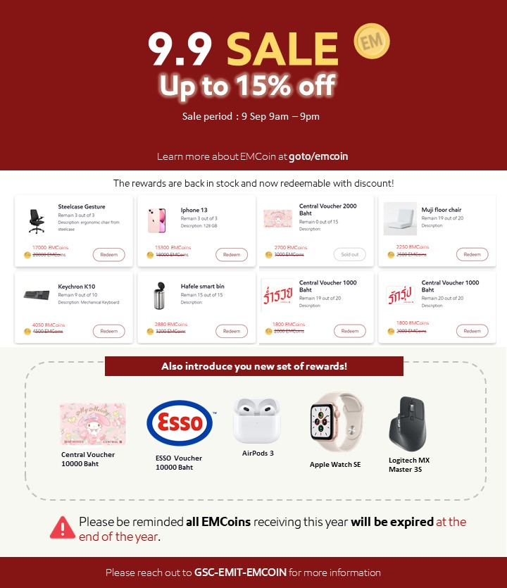
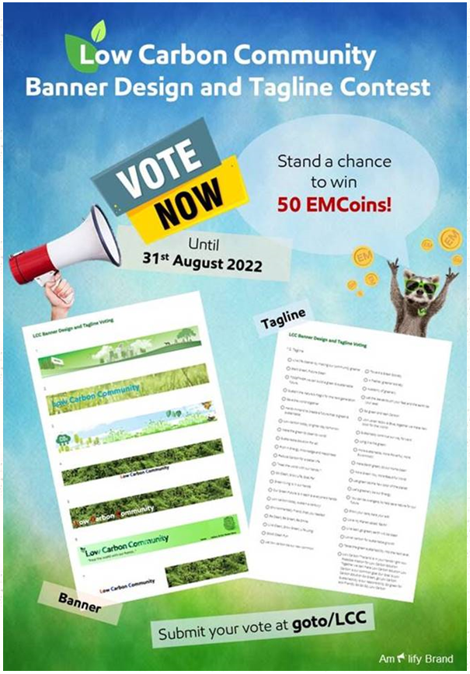
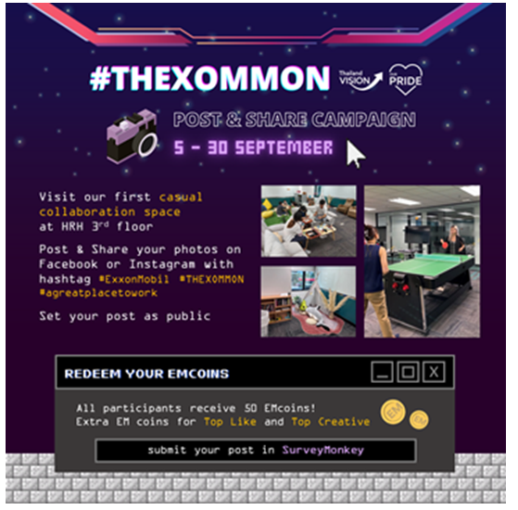



Slide 5
Matrix

Slide 6
Lesson learn/Recomendation

Slide 7
Plan
Idea from LTs

